Slide 1
ENERGY CONSUMPTION ACROSS
BUILDINGS
DATA ANALYSIS ESSENTIALS
TEAM MEMBERS
25B11CS718 – PASALA HARINI
25B11CS517 – LAVETI ROSHINI
25B11CS623 – MUPPANABOINA VAMSI KALYAN
25B11CS700 – PALIVELA PRAHARSHA SAI CHARAN
UNDER THE SUPERVISION OF
K Vydehi
Assistant Professor
Department of CSE

Slide 2
PROBLEM STATEMENT
Buildings consume significant global energy, yet many waste energy due to occupancy, weather, building type, and equipment usage. This project analyzes building energy data to identify consumption patterns, detect inefficiencies, and recommend ways to improve energy efficiency, reduce costs, and support sustainability.

Slide 3
OBJECTIVES
Collect and analyze energy data from multiple buildings.
Compare consumption across different building types.
Identify key factors affecting energy usage.
Detect abnormal consumption and energy wastage.
Visualize trends using charts and dashboards.
Recommend ways to improve efficiency and reduce costs.
Support sustainable energy management through data analytics.

Slide 4
DOMAIN SELECTION
Optimize Inventory: Stock high-demand flavors like Chocolate and Vanilla.
Improve Staffing & Prep: Adjust staff and batch preparation for peak sales days.
Targeted Marketing: Promote flavors based on customer age groups and preferences.

Slide 5
IMPORTANCE OF THE PROBLEM
Buildings consume 30–40% of global energy, contributing significantly to carbon emissions. Energy data analysis helps organizations:
Identify inefficient equipment.
Detect abnormal energy usage.
Reduce electricity costs.
Improve energy efficiency and sustainability.
Lower carbon emissions.

Slide 6
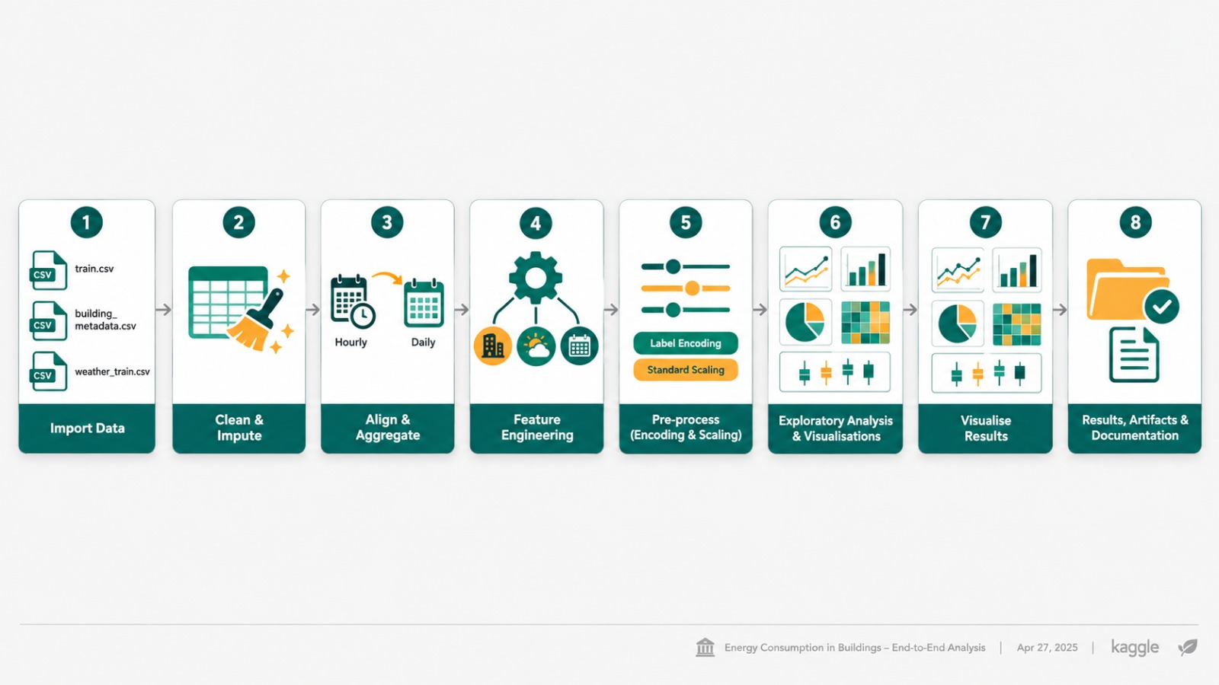
PROJECT WORK FLOW

Slide 7
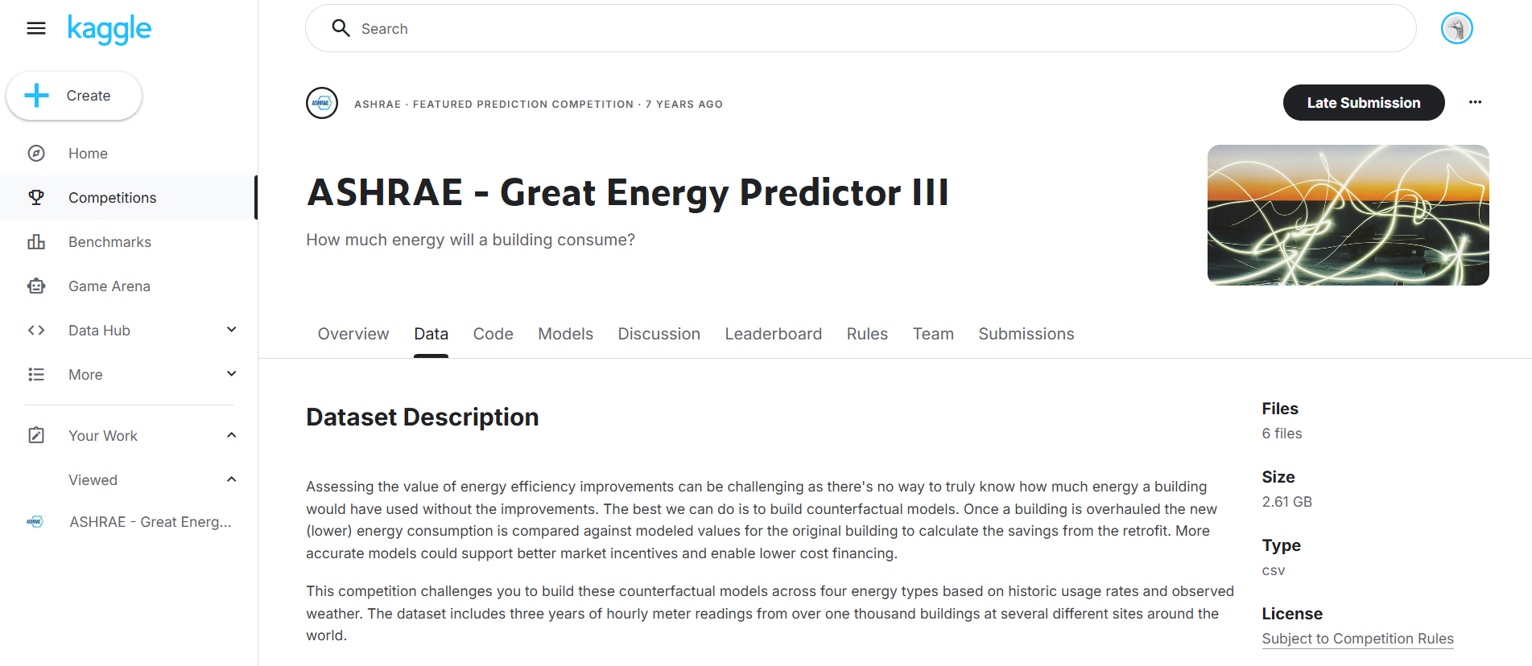
DATASET SELECTION AND
UNDERSTANDING
The dataset is from Kaggle’s ASHRAE competition, organized by the American Society of Heating, Refrigerating and Air-Conditioning Engineers. It contains multiple CSV files with building metadata, weather data, and energy meter readings (electricity, chilled water, hot water, and steam) for predicting building energy consumption.

Slide 8
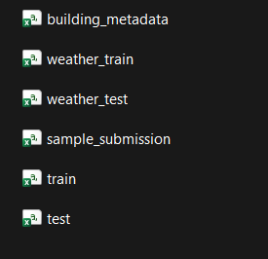
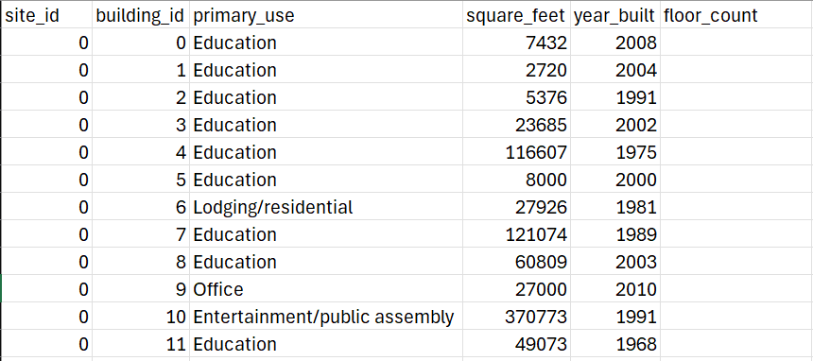
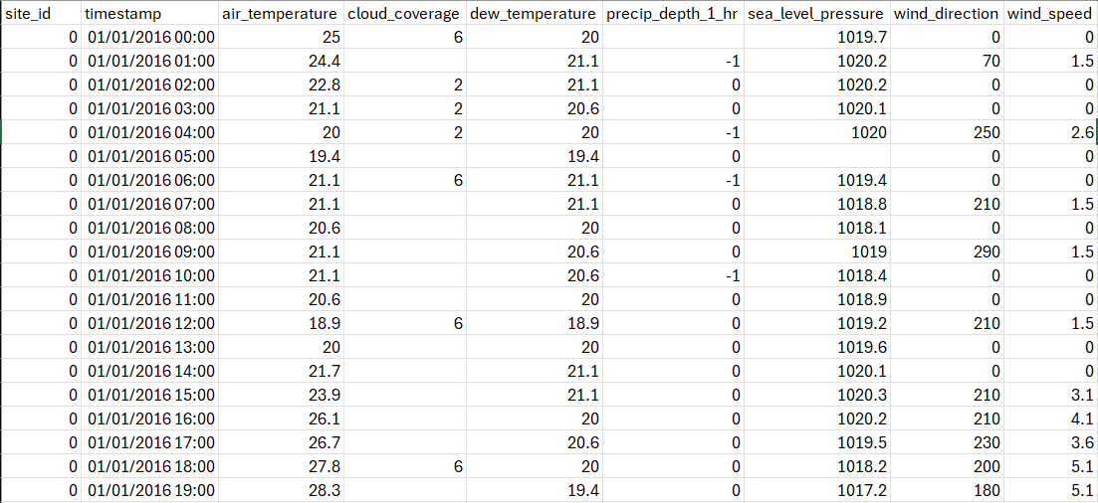
DATASET INSPECTION
The dataset includes building, weather, and energy attributes to analyze consumption:
Building: Building ID, square footage, year built, floor count, and primary use.
Weather: Temperature, humidity, cloud coverage, wind, pressure, and precipitation.
Meter: Electricity, chilled water, steam, or hot water.
Target: meter_reading — actual energy consumption (kWh) predicted by the model.

Slide 9
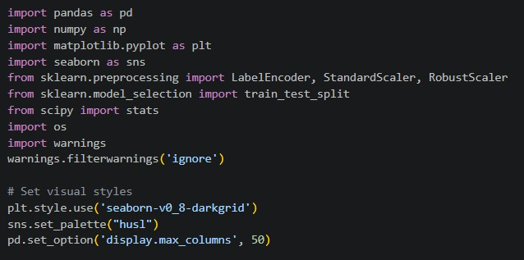
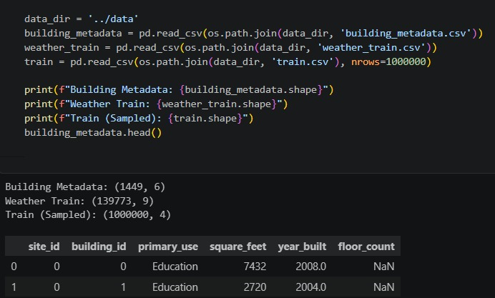
DATA PREPROCESSING
Dataset Import
The ASHRAE dataset was downloaded from Kaggle and imported into a Jupyter Notebook using Python's pandas library (pd.read_csv()).
Libraries and Modules Used
Pandas: Loads, organizes, and cleans datasets.
NumPy: Performs numerical calculations.
Matplotlib & Seaborn: Create graphs, plots, and heatmaps.
LabelEncoder: Converts categorical data into numbers.
StandardScaler & RobustScaler: Scale numerical features.
train_test_split: Splits data into training and testing sets.
SciPy: Performs statistical analysis.
OS: Manages file paths and dataset loading.
Warnings: Hides unnecessary warning messages.

Slide 10
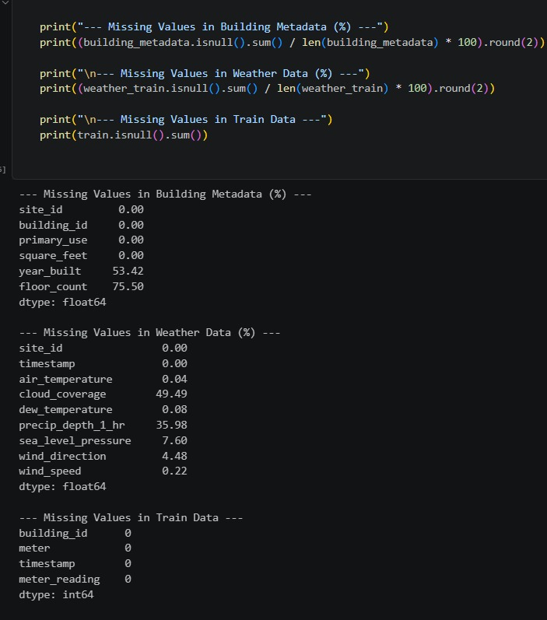
MISSING VALUES HANDLING
Data Inspection and Missing Value Analysis
The dataset was inspected to identify missing values in building metadata, weather data, and training data. Significant gaps were found in floor_count (75.50%), year_built (53.42%), and cloud_coverage (49.49%). These missing values were addressed through imputation before merging and cleaning the dataset.

Slide 11
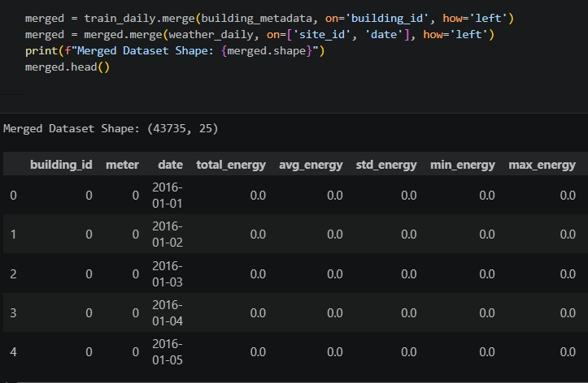
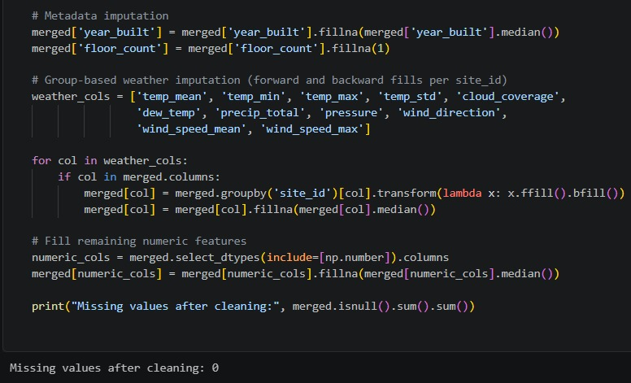
MISSING VALUES HANDLING
Missing values in year_built are replaced with the median, while floor_count is filled with 1. Weather data is imputed using site-wise forward and backward filling, followed by median imputation for remaining gaps. Other numerical features are also filled using their median values.

Slide 12
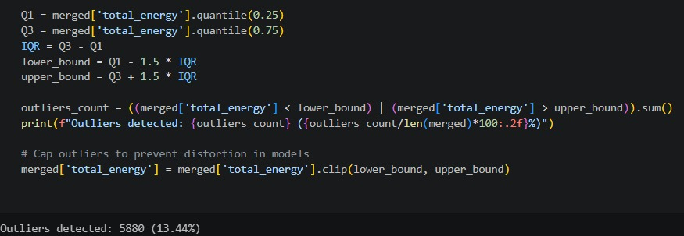
OUTLIERS DETECTION AND HANDLING
Outlier Detection and Treatment
Outliers in total energy consumption are identified using the IQR method (1.5 × IQR). A total of 580 outliers (13.44%) are detected and capped using lower and upper bounds to reduce their impact on analysis and modeling.

Slide 13
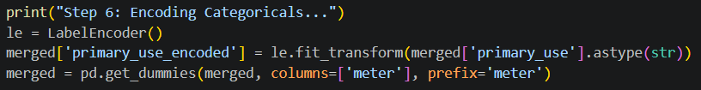
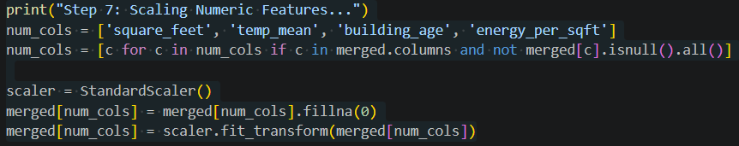
ENCODING AND SCALING
LabelEncoder converts text-based building usages into integers, while pd.get_dummies creates binary columns for meter types.
Continuous numerical variables—such as square footage, building age, and temperature—are standardized using StandardScaler to ensure all features share a zero mean and unit variance (Z = (x - mean) / std_dev).
This combined encoding and scaling step formats all categorical and numerical inputs into a uniform structure ready for model training.

Slide 14
PREPROCESSING SUMMARY
Data Inspection: Examined building metadata, weather data, and energy consumption records.
Missing Value Detection: Identified missing values in floor_count (75.50%), year_built (53.42%), and cloud_coverage (49.49%).
Missing Value Handling: Used median imputation for numerical features and forward and backward filling for weather data.
Data Cleaning: Cleaned and prepared the datasets for merging and further analysis.
Outlier Detection: Applied the IQR method (1.5 × IQR) to identify extreme energy consumption values.
Outlier Treatment: Detected 580 outliers (13.44%) and capped them using lower and upper bounds.
Categorical Encoding: Converts text labels into numbers using LabelEncoder for building types and one-hot encoding (pd.get_dummies) for meter types.
Feature Scaling: Uses StandardScaler to normalize continuous variables (like square footage and temperature) to a zero mean and unit variance.

Slide 15
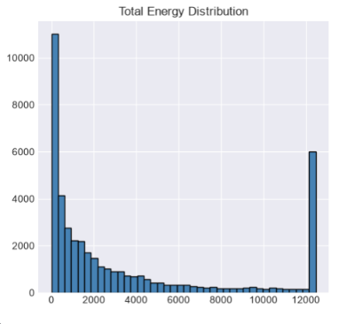
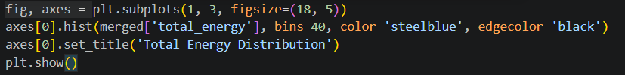
VISUALIZATION AND INTERPRETATION

Slide 16
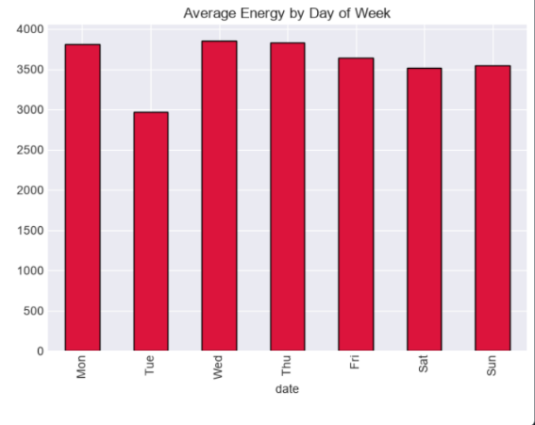
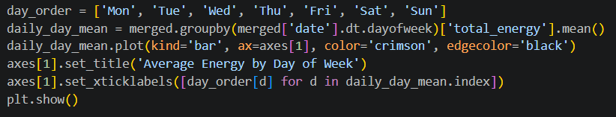
VISUALIZATION AND INTERPRETATION

Slide 17
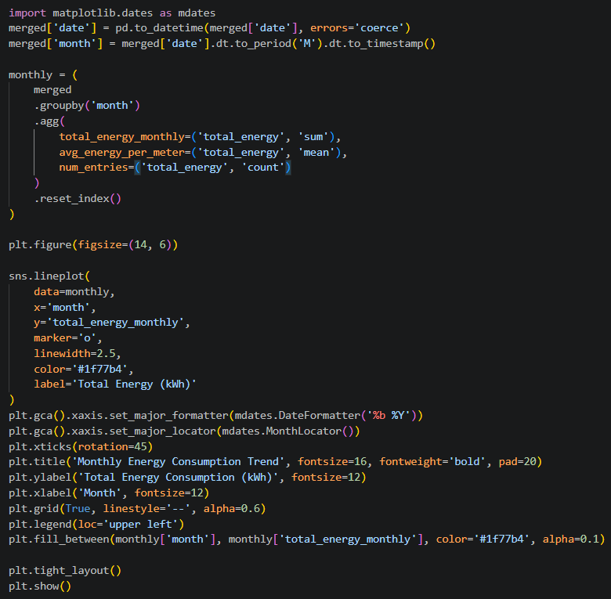
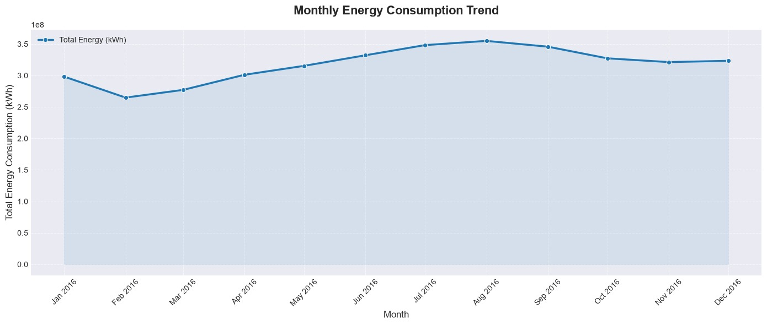
VISUALIZATION AND INTERPRETATION

Slide 18
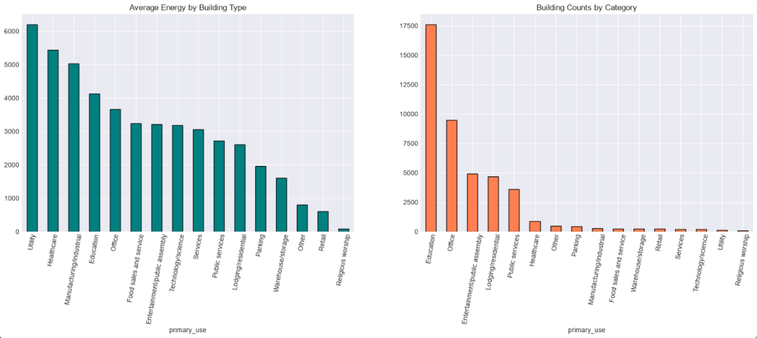
VISUALIZATION AND INTERPRETATION

Slide 19
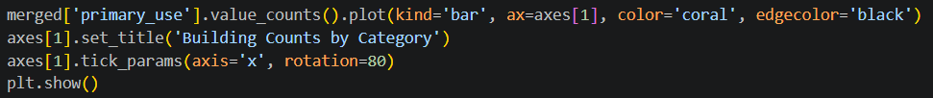
VISUALIZATION AND INTERPRETATION

Slide 20
CONCLUSION
Analyzed building energy consumption and key influencing factors.
Identified usage patterns based on building characteristics, weather, and time.
Highlighted opportunities to detect inefficiencies and reduce energy waste.
Provided insights to optimize energy costs and improve efficiency.
Demonstrated how data analytics supports sustainable energy management.
--- THANK YOU ---

